Slide 1

N -QUEENS USING GENETIC ALGORITHM
By : Vishnupriya(21071A66C8)

Slide 2
4
N-QUEENS PROBLEM
Row Conflict
The N Queen is the problem of placing N chess queens on an N×N chessboard so that no two queens attack each other.
No two Queens can be in the same row
Column Conflict
No two Queens can be in the same column
Diagonal Conflict
No two Queens can be in the same Diagonal

Slide 3
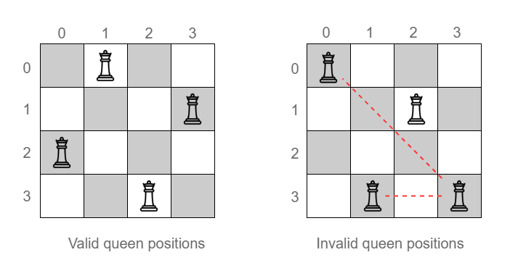
1
ATTACK POSITION

Slide 4
1
CHALLENGES IN SOLVING N-QUEENS PROBLEM
Exponential Growth: Time complexity is exponential
Combinatorial Explosion: As N increases, Search space increases exponentially
Optimality Difficulty: It is difficult to find the optimal solution

Slide 5
1
GENETIC ALGORITHM
Genetic algorithms are optimization algorithms inspired by the process of natural selection.
Key Components:
Selection: Choosing solutions based on their fitness.
Crossover: Combining genetic information to create new solutions.
Mutation: Introducing random changes to maintain diversity.

Slide 6
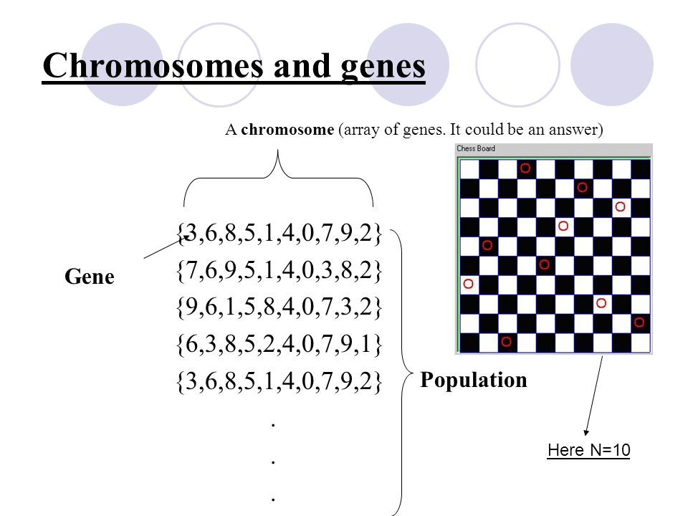
1
CHROMOSOME REPRESENTATION

Slide 7
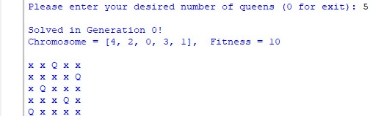
1
IMPLEMENTATION
5 Queens

Slide 8
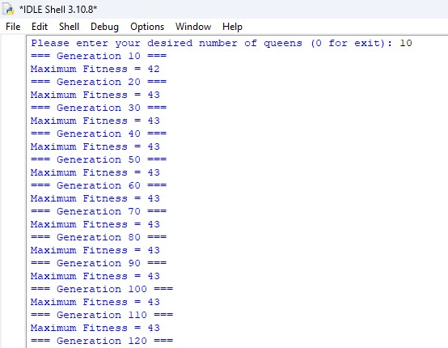
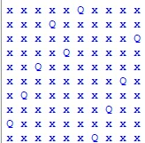
1
10-QUEENS

Slide 9
1
CONCLUSION
Genetic Algorithm alone is insufficient to tackle large chessboards. Genetic algorithm along with other evolutionary algorithms are to be combined to reach maximun efficiency

Slide 10
THANK YOU

